Slide 1
CS212-Object Oriented Programming
Lecture 13
Study with Course Book and https://www.w3schools.com/java/

Slide 2
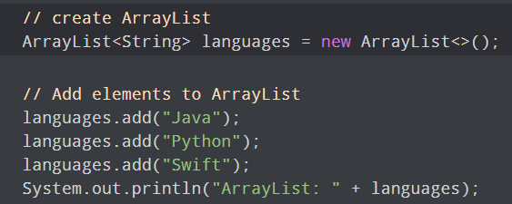

ArrayList Class
In Java, we need to declare the size of an array before we can use it. Once the size of an array is declared, it's hard to change it.
To handle this issue, we can use the ArrayList class. It allows us to create resizable arrays.
Unlike arrays, ArrayList can automatically adjust its capacity when we add or remove elements from it. Hence, ArrayList are also known as dynamic arrays.

Slide 3
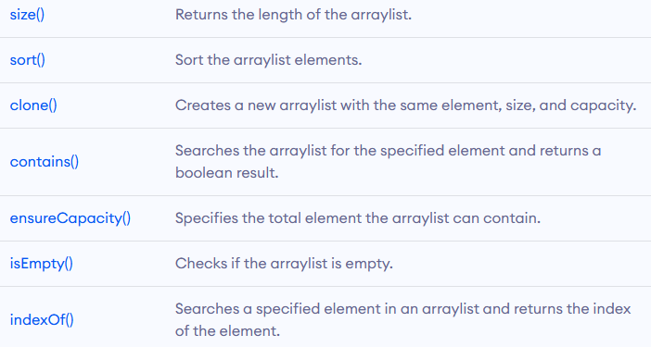
ArrayList Class
The ArrayList class provides various methods to perform different operations like
Add elements
Access elements
Change elements
Remove elements

Slide 4
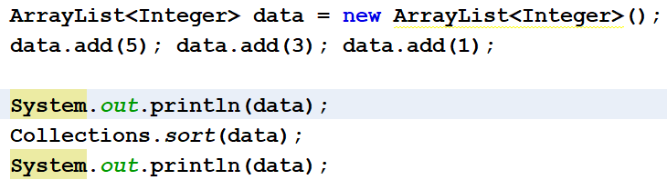

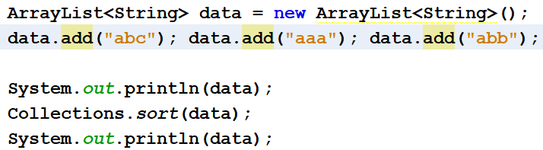

ArrayList Class
ArrayList class provides a method for sorting the elements

Slide 5
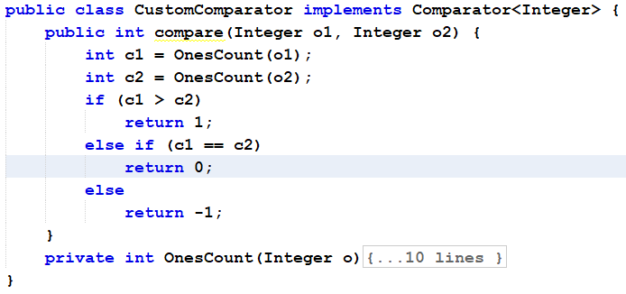
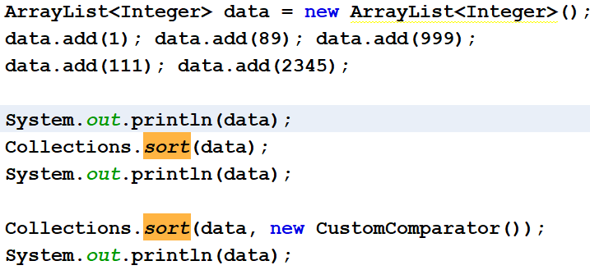
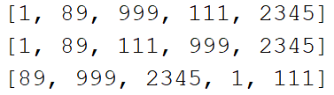
ArrayList Class – Custom Sort

Slide 6
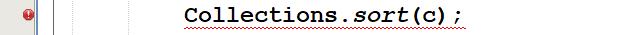
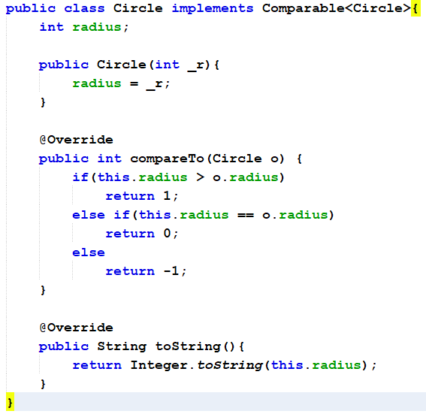
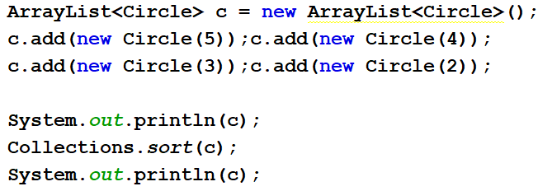

ArrayList Class – Custom Class Sort
Whats difference in Comparable and Comparator interface
Study Cloneable Interface (course book section 13.7)

Slide 7
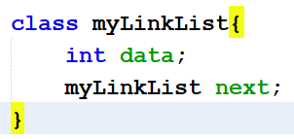
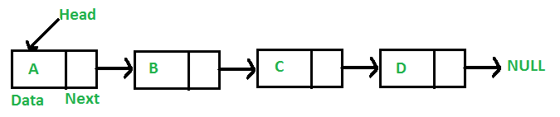
LinkedList
The LinkedList class has all of the methods as ArrayList class because they both implement List interface.
The ArrayList class has a regular array inside it. If the array is not big enough, a new, larger array is created to replace the old one and the old one is removed.
The LinkedList stores its items in "containers." The list has a link to the first container and each container has a link to the next container in the list. To add an element to the list, the element is placed into a new container and that container is linked to one of the other containers in the list.

Slide 8
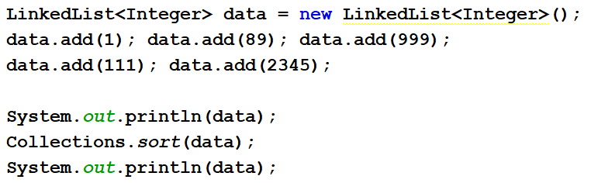

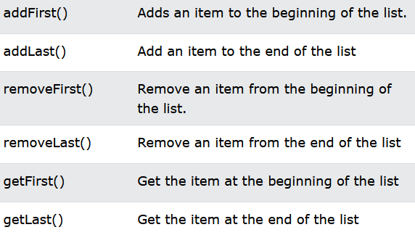
LinkedList
Compare performance of ArrayList and LinkedList, submit by Sunday

Slide 9
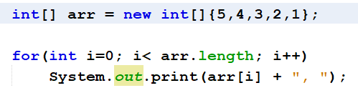
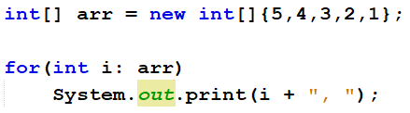
Foreach loop
For-each is another array traversing technique like for loop, while loop, do-while loop
Instead of declaring and initializing a loop counter variable, you declare a variable that is the same type as the base type of the array, ArrayList, LinkedList etc
In the loop body, you can use the loop variable you created rather than using an indexed array element

Slide 10
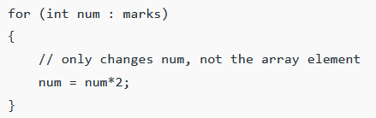
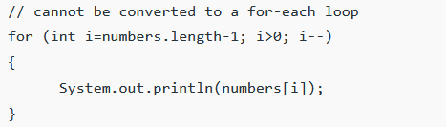
Foreach loop
Limitations of for-each loop
not appropriate when you want to modify the array
do not keep track of index
only iterates forward over the array in single steps
some performance overhead over simple iteration

Slide 11
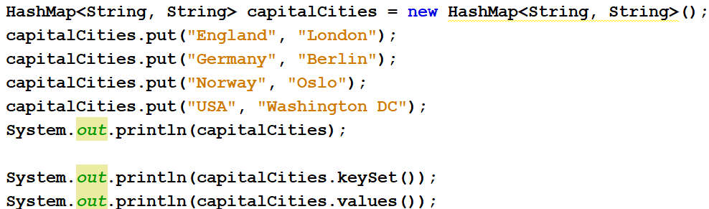
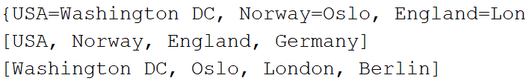
Hashmap
A HashMap stores items in "key/value" pairs
One object is used as a key (index) to another object (value).
It can store different types: String keys and Integer values, or the same type, like: String keys and String values.

Slide 12
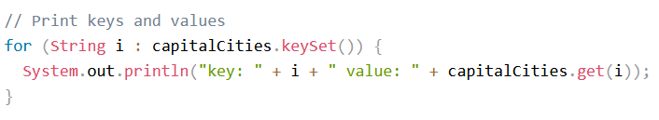
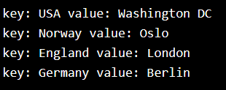
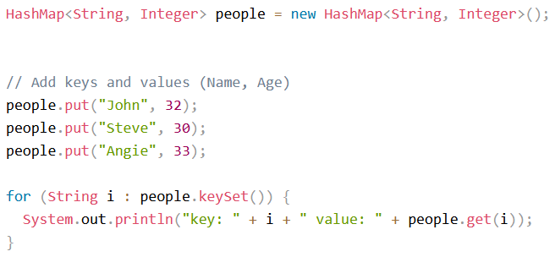
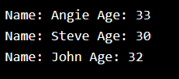
Hashmap
capitalCities.get("England"); capitalCities.remove("England"); capitalCities.clear(); capitalCities.size();

Slide 13
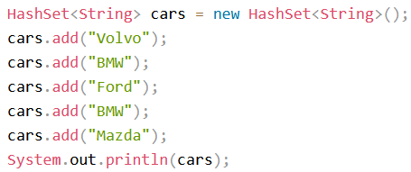

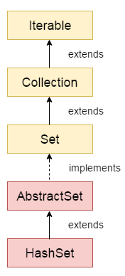
HashSet
A HashSet is a collection of items where every item is unique
cars.contains("Mazda");
cars.remove("Volvo");
cars.clear();
cars.size();
Find inheritance chain of other data types and collections

Slide 14
Access Modifiers
Access Modifier is used to set the access level for classes, attributes, methods and constructors.
We divide modifiers into two groups:
Access Modifiers - controls the access level
Non-Access Modifiers - do not control access level, but provides other functionality
Access Modifiers For Classes
Public: accessible by any other class
Default : accessible by classes in the same package. This is used when you don't specify a modifier.

Slide 15
Access Modifiers
Access Modifiers attributes, methods & constructor
Public: accessible for all classes
Private: accessible within the declared class
Default: accessible in the same package. This is used when you don't specify a modifier.
Protected: accessible in the same package and subclasses

Slide 16
Access Modifiers
Non-Access Modifiers – Classes
Final: class cannot be inherited by other classes
Abstract: class cannot be used to create objects
Non-Access Modifiers – attributes and methods
Final: Cannot be overridden/modified
Static: Belongs to class, rather than object
Abstract: Abstract methods does not have a body and a subclass will provide its implementation. Can only be used with a method in abstract class.
Transient: Skipped when serializing the object
Synchronized: Methods can only be accessed by one thread at a time
Volatile: Attribute is not cached thread-locally, and is always read from the "main memory"

Slide 17
Regular Expression
A regular expression is a sequence of characters that forms a search pattern. When you search for data in a text, you can use this search pattern to describe what you are searching for.
A regular expression can be a single character, or a more complicated pattern.
Regular expressions can be used to perform all types of text search and text replace operations.
Java does not have a built-in Regular Expression class, but we can import the java.util.regex package
Pattern Class - Defines the pattern
Matcher Class - Used to search for the pattern
PatternSyntaxException Class - Indicates syntax error in a regular expression pattern

Slide 18
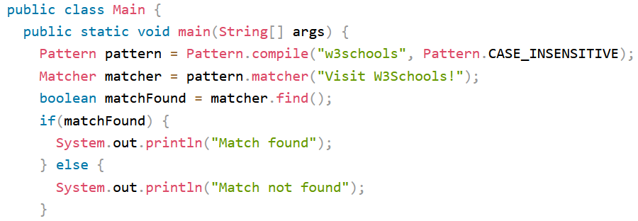
Regular Expression
Flags in the compile() method change how the search is performed
Pattern.CASE_INSENSITIVE
Pattern.LITERAL
Pattern.UNICODE_CASE
ENUM

Slide 19
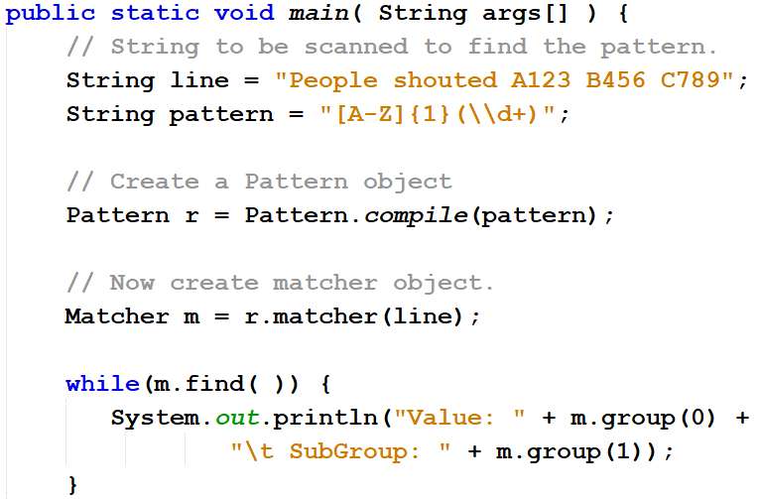

Regular Expression

Slide 20
Regular Expression
[abc] | Find one character from the options
[^abc] | Find one character NOT between the brackets
[0-9] | Find one character from the range 0 to 9
\d | Find a digit
\s | Find a whitespace character
\b | Find a match at the beginning of a word like this: \bWORD, or at the end of a word like this: WORD\b
n+ | Matches any string that contains at least one n
n* | contains zero or more occurrences
n? | contains zero or one occurrences

Slide 21
Regular Expression
n{x} | Matches any string that contains a sequence of X n's
n{x,y} | Matches any string that contains a sequence of X to Y n's
n{x,} | Matches any string that contains a sequence of at least X n's
| | Find a match for any one of the patterns separated by | as in: cat|dog|fish
. | Find just one instance of any character
^ | Finds a match as the beginning of a string as in: ^Hello
$ | Finds a match at the end of the string as in: World$
\uxxxx | Find the Unicode character specified by the hexadecimal number xxxx

Slide 22
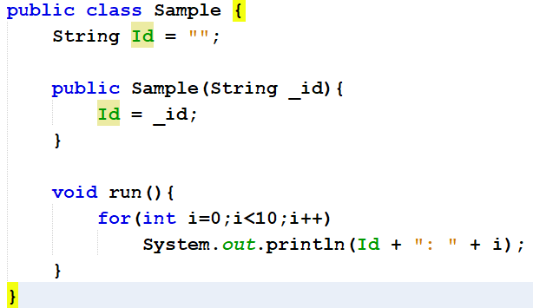
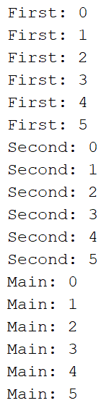
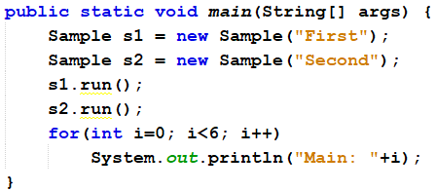
Java Threads
Threads allows a program to operate more efficiently by doing multiple things at the same time.
Threads can be used to perform complicated tasks in the background without interrupting the main program.

Slide 23
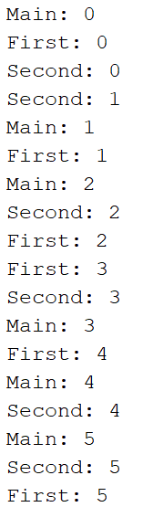
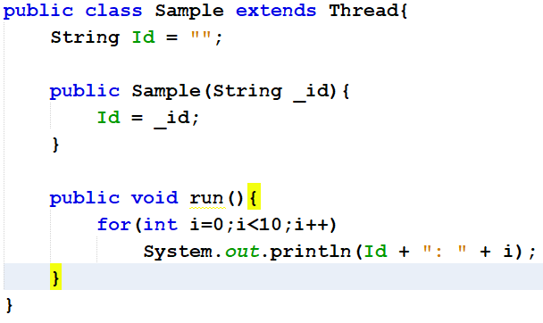
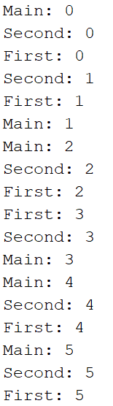
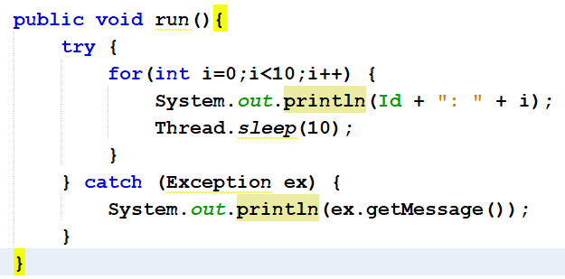

Java Threads

Slide 24
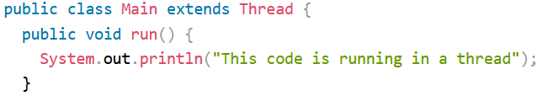

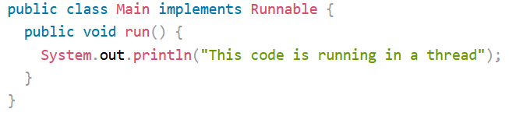

Java Threads
Two ways to create a thread…
Study Task, Service, FutureTask class and Worker Interface for multi-threading in JavaFx

Slide 25
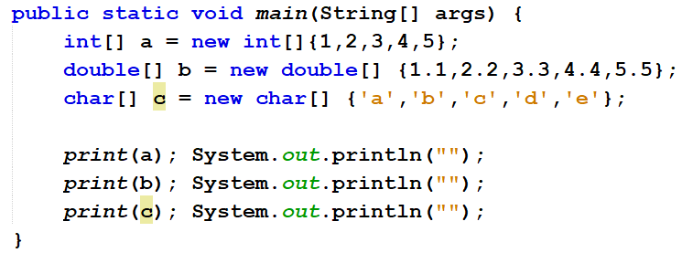
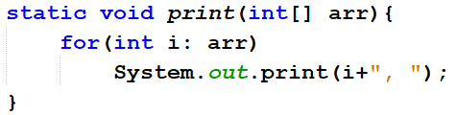
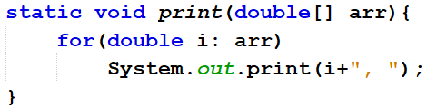
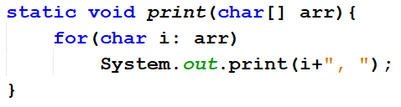
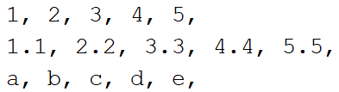
Generics
How to Generalize all print methods?

Slide 26
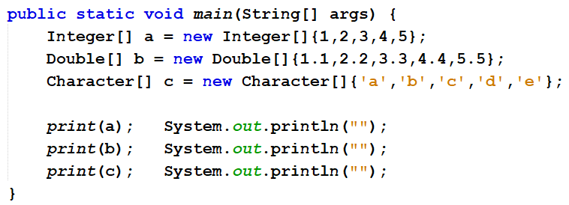
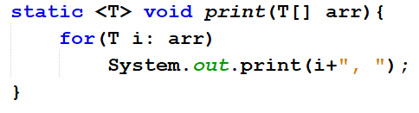
Generics
Does this print method work for Custom Classes?

Slide 27
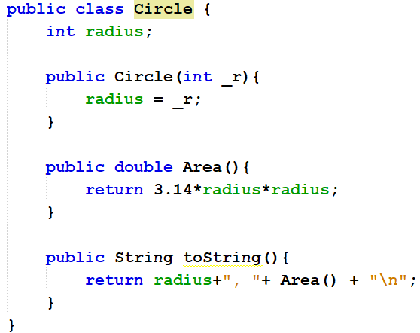
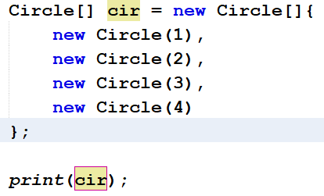
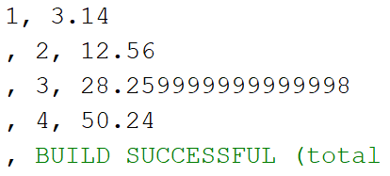
Generics
Generic Methods with Multiple Types, Possible? - Study

Slide 28
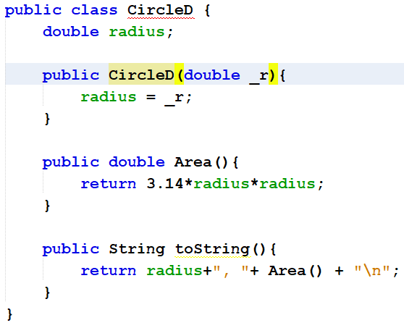
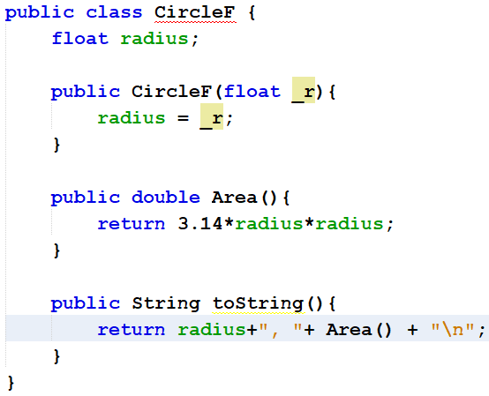
Generics
How to Generalize all the Circle classes?

Slide 29
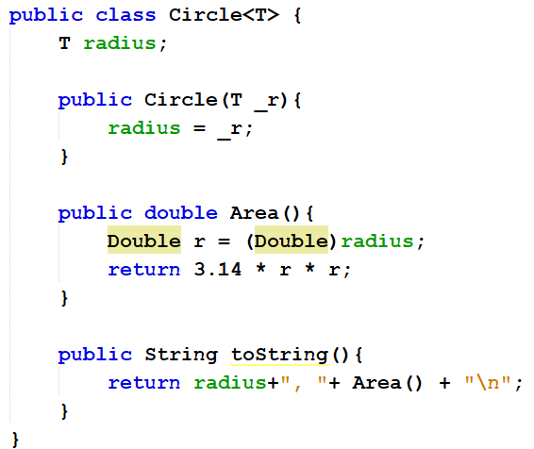


Generics
Generics with Multiple Types, Possible?

Slide 30
Generics
Java generics allow implementation of related methods an classes with a single declaration
E.g A generic method for sorting an array of objects can be invoked with Integer, Double, String arrays and so on…
Can we restrict the kinds of types that are allowed to be passed in a generic method/ class
More on generics at
Chapter 19 of Course Book
https://www.tutorialspoint.com/java/java_generics.htm
https://www.geeksforgeeks.org/generics-in-java/
https://www.programiz.com/java-programming/generics
https://www.baeldung.com/java-generics
https://docs.oracle.com/javase/tutorial/java/generics/index.html

Slide 31


Generics
Yes, Bounded Types with Generics in Java (Study)

Slide 32

Java Enums
An enum is a special "class" that represents a group of constants (unchangeable variables, like final variables).
Enum is short for "enumerations“ => "specifically listed".
To create an enum, use the enum keyword (instead of class or interface), and separate the constants with a comma. Note that they should be in uppercase letters

Slide 33


Java Enums
It is possible to use enum with
if-else, switch, loops etc…
See Appendix I of course book

Slide 34
Java Enums
An enumerated type is treated as a special class.
An enumerated type variable is therefore a reference variable. An enumerated type is a subtype of the Object class and the Comparable interface.
Therefore, an enumerated type inherits all the methods in the Object class and the compareTo method in the Comparable interface.
Additionally, you can use the following methods on an enumerated object:
public String name(); Returns a name of the value.
public int ordinal(); Returns the ordinal value associated with the enumerated value. The first value in an enumerated type has an ordinal value of 0, the second has an ordinal value of 1, and so on

Slide 35

Java Inner Classes
In Java, it is also possible to nest classes (a class within a class). The purpose of nested classes is to group classes that belong together, which makes your code more readable and maintainable.

Slide 36

Java Inner Classes
Private Inner Class
Unlike a "regular" class, an inner class can be private or protected. If you don't want outside objects to access the inner class, declare the class as private

Slide 37

Java Inner Classes
Static Inner Class
An inner class can also be static, which means that you can access it by using outer class name (without creating an object of the outer class)

Slide 38

Java Inner Classes
Access Outer Class From Inner Class
One advantage of inner classes, is that they can access attributes and methods of the outer class

Slide 39
Database
Database
A collection of related data stored in a manner that enables information to be retrieved as needed
Database Management System (DBMS)
Used to create, maintain, and access databases
Database engine
The part of the program that actually stores and retrieves data
Microsoft Access, OpenOffice Base, Corel Paradox, Oracle Database, etc.

Slide 40

Database
A database typically consists of:
Tables: Collection of related records
Fields (columns): Single category of data
Records (rows): Collection of related fields

Slide 41
Database
A database most often contains one or more tables. Each table is identified by a name
SQL is a standard language for accessing and manipulating databases
Important SQL statements are
SELECT - extracts data from a database
UPDATE - updates data in a database
DELETE - deletes data from a database
INSERT INTO - inserts new data into a database

Slide 42

Database
SELECT CustomerName, City FROM Customers;
SELECT * FROM Customers;
Retrieve all records from the table customers

Slide 43


Database
SELECT Country FROM Customers;
SELECT DISTINCT Country FROM Customers;

Slide 44




Database
SELECT * FROM Customers WHERE Country='Mexico';

Slide 45



Database

Slide 46
Database

Slide 47
Database
Java Database Connectivity (JDBC) is a Java API for connecting programs written in Java to the data in relational databases
The JDBC API contains methods to communicate with DBMS or RDBMS
The JDBC API uses the JDBC driver to carry out it tasks
Establish a connection with a data source
Send queries and update statements to data source
Process the results

Slide 48


Database

Slide 49
Database
JDBC Steps
Instantiate proper driver
Open connection to database
Connect to database
Query database (or insert/update/delete)
Process the result
Close connection to database

Slide 50

Database

Slide 51
Serialization
Serialization in Java is a mechanism of writing the state of an object into a byte-stream
Object can be represented as a sequence of bytes that includes the object's data as well as information about the object's type and the types of data stored in object
Reverse operation is called deserialization
The serialization and deserialization process is platform-independent, it means you can serialize an object on one platform and deserialize it on a different platform.
ObjectInputStream and ObjectOutputStream classes contain methods for serializing & deserializing an object.
To serialize object, implement Serializable interface

Slide 52

Serialization
Serializable is a marker interface (has no data member and method). It is used to "mark" Java classes so that the objects of these classes may get a certain capability. The Cloneable and Remote are also marker interfaces.
The String class and all the wrapper classes implement the java.io.Serializable interface by default.

Slide 53



Serialization

Slide 54
Java Lambda Expressions
Lambda Expressions were added in Java 8.
A lambda expression is a short block of code which takes in parameters and returns a value.
Lambda expressions are similar to methods, but they do not need a name and they can be implemented right in the body of a method.
Possible Syntax format are
parameter -> expression
(parameter1, parameter2) -> expression
(parameter1, parameter2) -> { code block }

Slide 55


Java Lambda Expressions

Slide 56


Java Lambda Expressions
https://www.javatpoint.com/java-lambda-expressions
https://www.geeksforgeeks.org/lambda-expressions-java-8/

Slide 57

Java Packages
A package in Java is used to group related classes. Packages are divided into two categories:
Built-in Packages (packages from the Java API)
User-defined Packages (create your own packages)
Built-in Packages
prewritten classes, that are free to use, included in the Java Development Environment. Complete list at https://docs.oracle.com/javase/8/docs/api/
Divided into packages and classes. You can either import a single class or a whole package.

Slide 58


Java Packages
User-defined Packages
Java uses a file system (just like folders) directory to store packages
To create a package, use the package keyword
Compile: javac –d . MyPackageClass.java

Slide 59
Design Patterns
Design patterns represent the best practices used by experienced object-oriented software developers
Problem: create a class for which only a single instance can be created. Sol: Singleton Design Pattern
Every design pattern has some specification or set of rules for solving the problems
20+ design patterns can be classified into 3x categories i.e Creational, Structural and Behavioral patterns
More on Design Patterns ate
https://www.tutorialspoint.com/design_pattern/design_pattern_overview.htm
https://www.javatpoint.com/design-patterns-in-java
https://www.journaldev.com/1827/java-design-patterns-example-tutorial
https://refactoring.guru/design-patterns/java

Slide 60



Unit Testing
Unit Testing is a methodology of testing source code for its fitment of use in production
Unit testing is the first level of testing done before integration and other remaining levels of the testing
Write Code to test the Code
JUnit is a unit testing framework for the Java programming language
More at
https://www.baeldung.com/java-unit-testing-best-practices
https://www.vogella.com/tutorials/JUnit/article.html
https://www.javatpoint.com/unit-testing

